Slide 1

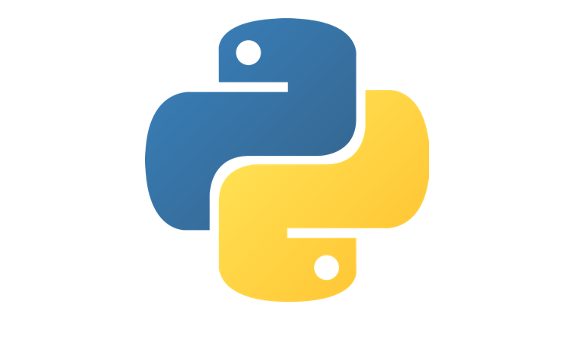
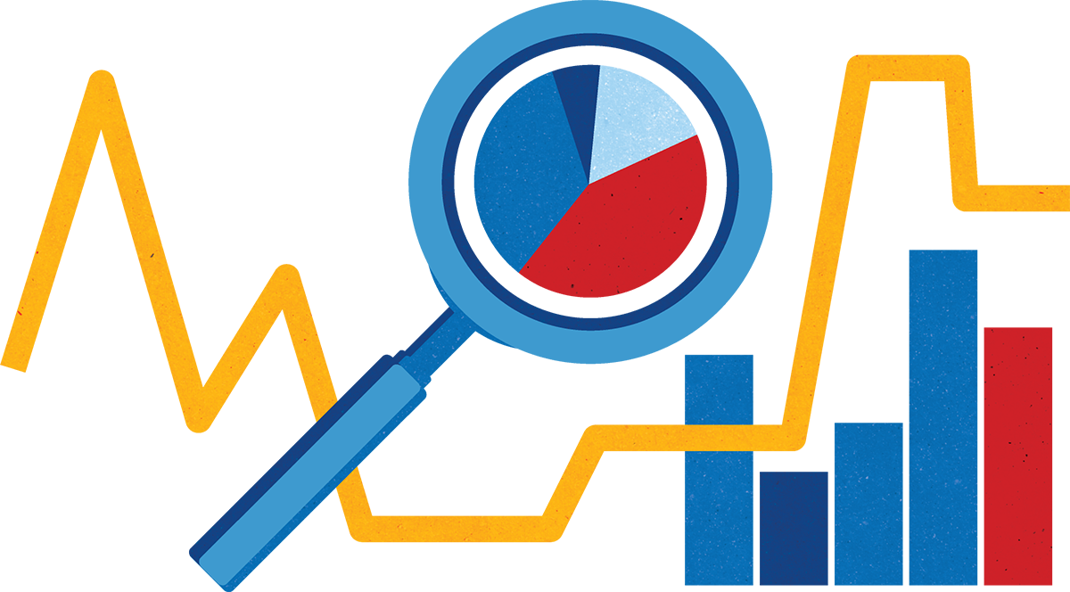
Welcome to Python for Data Analysis!

Slide 2
Introduction to Python
Python
This course is the first step to take to becoming knowledgable of the basics of Python.
The main goal of this course to guide you through the fundamentals of Python programming language.
This course will take you from a state of complete programming illiteracy to a level programming knowledge which allows you to desiign, write, debug and run programs encoded in the Python language.

Slide 3
Introduction to Python
Course Syllabus
In this course you will learn:
Python Syntax and Variable Types
Python Functions
Control Flow
Lists
Loops
Python Strings
Dictionaries
Python Files
Lambda Functions

Slide 4
Introduction to Python
Why Python?
Python is the most used language in the world at the moment. It is most sort out because of its simple syntax, speed and is a high-level language.
There are billions of code written in Python, which means there is unlimited opportunities to reuse code and learn from well-crafted examples
There is a large and very active Python community, who are always happy to help
Easy to learn
Easy to use for writing new software
Easy to obtain, install and deploy

Slide 5
Introduction to Python
Where Python is used in modern age?
Python is used in game development. Games such as Battlefield 2, Battlefield 2142 and Battlefield Heroes use Python logic and server controls.
Python is used for web development. Major websites and services such as Dropbox, Uber, Spotify, Pinterest, BuzzFeed etc. use Python for development.
Other examples:
Internet Applications (BitTorrent)
Office Appplications
Mobile Applications
Enterprise Applications

Slide 6
Introduction to Python
Where Python can be used for?
Software Development (management, testing)
Web and Internet Development (Django, Flask)
Scientific and numeric computing (Scipy - collection of packages for purposes of mathematics, science and engineering)
Education (Great language for starting programming journey)
Desktop GUIs (Kivy, wxWidgets)
Business applications (E-commerce systems - Odoo)
(Source: https://www.python.org/about/apps)

